Slide 1

Practical 8
Find Merge Point (Intersection) of Two Sorted Linked Lists

Slide 2

Lesson Plan
Subject/Course | Competitive Coding
Lesson Title | Find Merge Point of Two Sorted Linked Lists
Lesson Objectives
Find Merge Point (Intersection) of Two Sorted Linked Lists
Detect whether two singly linked lists intersect (share nodes).
Achieve O(m + n) time and O(1) extra space.
When lists intersect they share the same tail from the merge point onward.

Slide 3
Problem Statement:
Write a program to find the Merge point of two sorted linked lists.

Slide 4
Concept
A linked list is a linear data structure composed of a sequence of nodes, where each node contains data and a pointer (or reference) to the next node in the sequence.
Common operations:
Insertion: Adding a new node to the linked list
Deletion: Removing a node from the linked list.
Traversal
Searching

Slide 5
Algorithm/Logic
1. Step by Step Pseudocode:
Compute lengths lenA and lenB of both lists.
Advance the longer list by abs(lenA - lenB) steps.
Walk both lists step-by-step comparing node references.
First node where nodeA == nodeB is the intersection. If none — return null.

Slide 6
Visualization
Two lists intersecting at node X:
List A: A1 -> A2 -> A3 \
-> X -> X.next -> ...
List B: B1 -> B2 /
Walk alignment (after advancing longer list or via pointer switching):
After advancing longer:
A3 -> X -> ...
B2 -> X -> ...

Slide 7
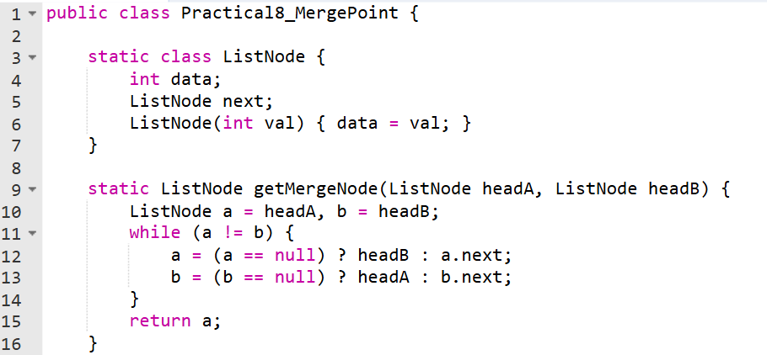
Code Implementation

Slide 8
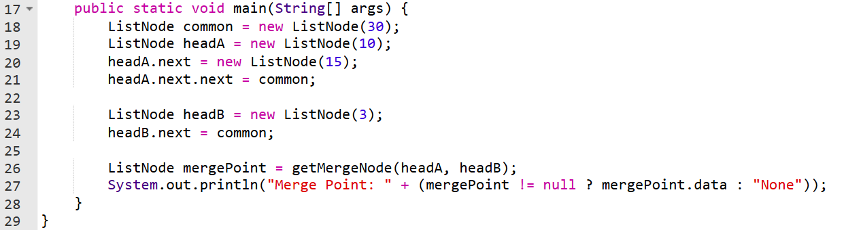
Code Implementation

Slide 9
Output :
Merge Point: 30

Slide 10
Time & Space Complexity
The time complexity of the getIntersectionNode function is O(M + N), where M is the length of the first linked list (headA) and N is the length of the second linked list (headB).
The space complexity of the getIntersectionNode function is O(1).

Slide 11
Summary
This algorithm cleverly handles lists of different lengths by "re-routing" the pointers to the head of the other list once they reach the end of their own list. This ensures that both pointers will eventually traverse the same total distance before meeting at the intersection or at NULL.

Slide 12
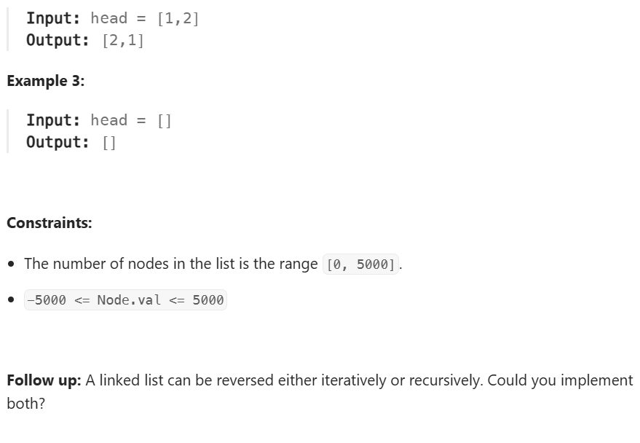
Practice Exercises
Problem Statement 1
Problem Statement Path:
Competitive Coding
Linked List
Reverse Linked List
Link :https://leetcode.com/problems/reverse-linked-list/description/

Slide 13
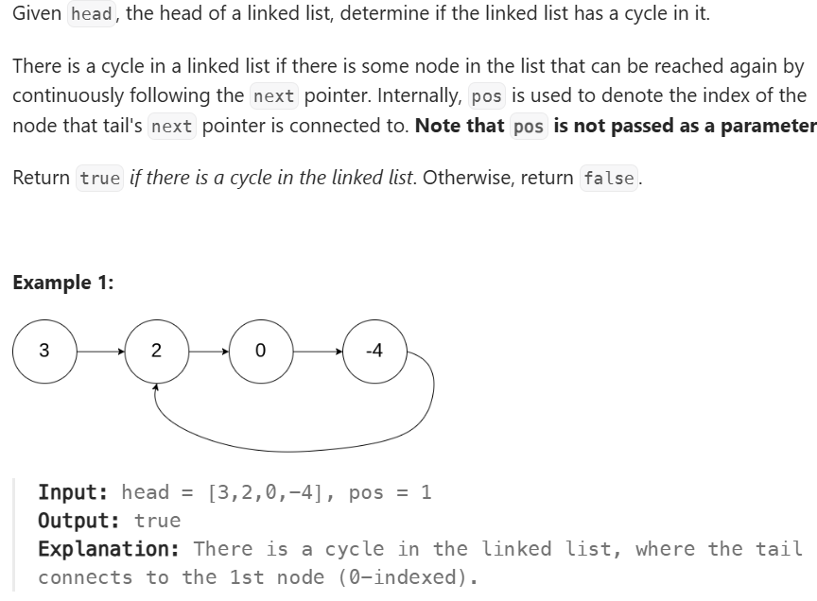
Practice Exercises
Problem Statement 2
Problem Statement Path:
Competitive Coding
Linked List
Linked List Cycle
Link: https://leetcode.com/problems/linked-list-cycle/description/

Slide 14
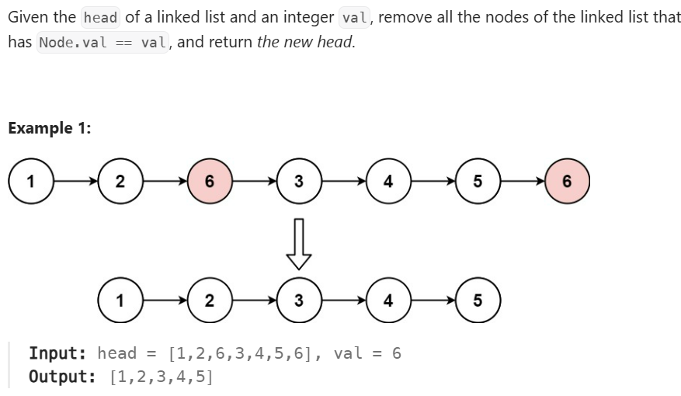
Practice Exercises
Problem Statement 3
Problem Statement Path:
Competitive Coding
Linked List
Remove Linked List Elements
Link: https://leetcode.com/problems/remove-linked-list-elements/description/

Slide 15
Thanks

